Slide 1

Slide 1
Stock Price Prediction

Slide 2
Outline
Executive Summary
Introduction
Methodology
Results
Conclusion
Appendix
2

Slide 3
Executive Summary
Below is a capstone project outline along with code snippets for each section using Python and popular libraries such as Pandas, Matplotlib, Seaborn, and Scikit-learn. This example assumes a hypothetical dataset related to stock price prediction.
3

Slide 4
Introduction
Data Collection Methodology
Gather relevant data to understand customer behavior and build a predictive model for churn prediction.
Exploratory Data Analysis (EDA)
Understand the structure, patterns, and relationships in the data to gain insights.
Interactive Visual Analytics
Create interactive visualizations to explore the data and identify patterns
Predictive Analysis
Build a predictive model to forecast customer churn
Model Tuning
Optimize model performance by tuning hyperparameters.
4

Slide 5
Data Collection Methodology
In This project, we'll be using historical stock data from Yahoo Finance
Understanding Data Availability: Before proceeding, it's important to check the availability and accessibility of the data. Yahoo Finance provides historical stock data for various publicly traded companies.
Accessing Data Programmatically: We'll utilize Python's pandas library to programmatically retrieve the data. Yahoo Finance provides data in CSV format, which can be easily fetched using its API.
Extracting Relevant Features: Determine which features (columns) from the dataset are relevant for your analysis. For stock data, common features include Date, Open, High, Low, Close, and Volume.
Handling Missing Data: Check if there are any missing values in the dataset and decide how to handle them. You may choose to drop missing values, fill them with a specific value (e.g., mean, median), or use more advanced techniques like interpolation.
Data Preprocessing: Perform any necessary preprocessing steps, such as converting data types, normalizing or scaling features, and handling outliers.
Data Storage: Decide on the storage format for your data. You can save the collected data to a CSV file, a database (e.g., SQLite, PostgreSQL), or even a cloud storage service.
5

Slide 6
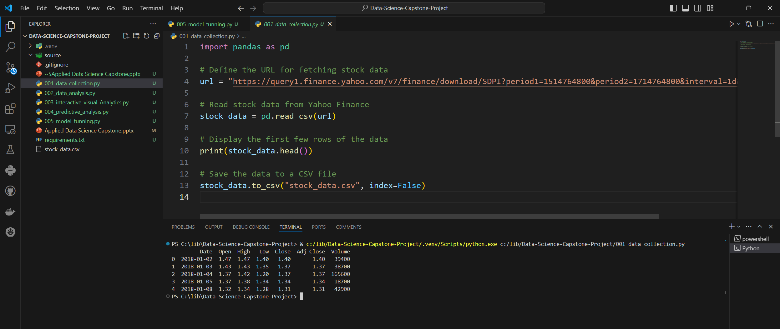

Slide 7
Data wrangling
7
Data wrangling involves cleaning and transforming raw data into a format that is more suitable for analysis. Here's a basic outline of the data wrangling process:
Load Data: Load the raw data into a DataFrame.
Explore Data: Explore the data to understand its structure, identify missing values, outliers, and inconsistencies.
Handle Missing Values: Decide how to handle missing values, whether to remove them, impute them, or leave them as-is.
Handle Duplicates: Identify and remove any duplicate rows in the dataset.
Convert Data Types: Convert data types of columns if necessary (e.g., convert strings to dates, numerical data types).
Transform Data: Perform any necessary transformations such as feature engineering, scaling, or normalization.
Handle Outliers: Decide how to handle outliers, whether to remove them, transform them, or leave them as-is.
Handle Inconsistencies: Address any inconsistencies or errors in the data, such as typos or incorrect values.
Merge or Concatenate Data: If working with multiple datasets, merge or concatenate them as needed.
Export Data: Export the cleaned and transformed data for further analysis.
7

Slide 8
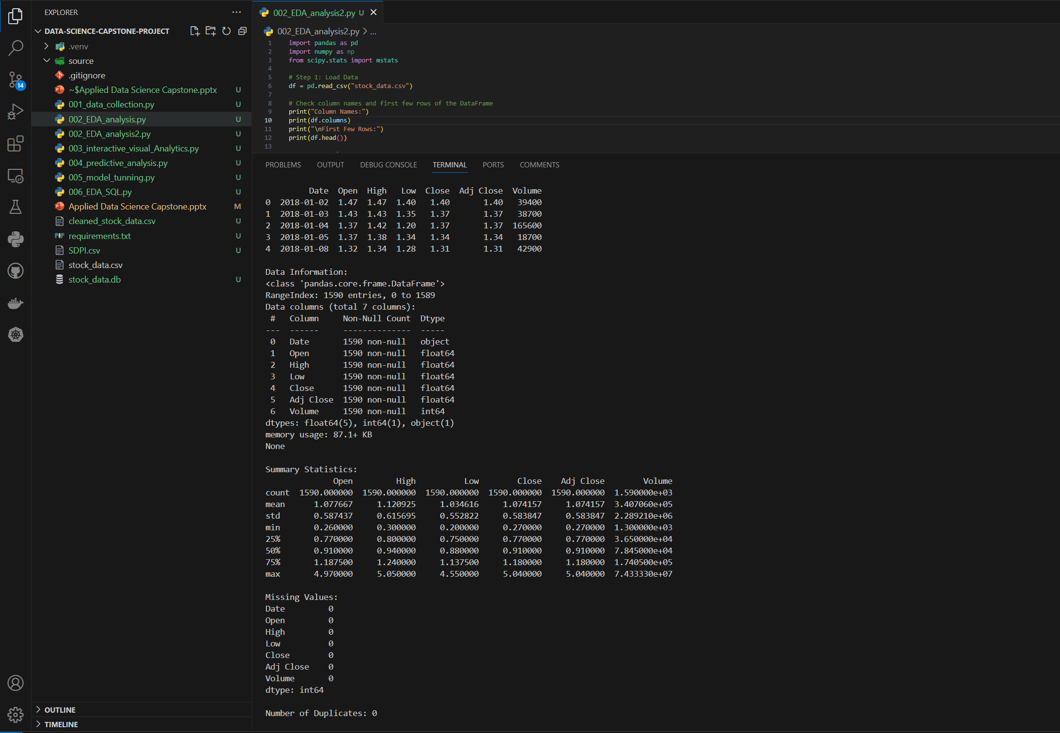

Slide 9
Exploratory Data Analysis (EDA)
Summary Statistics: Compute descriptive statistics to summarize the central tendency, dispersion, and shape of the dataset. This includes measures like mean, median, mode, standard deviation, minimum, maximum, and percentiles.
Data Visualization: Create visualizations to gain insights into the data distribution and relationships between variables. Common types of plots for stock data include line plots, histograms, scatter plots, box plots, and heatmaps.
Time Series Analysis: Since stock data typically involves a time component, perform time series analysis to identify trends, seasonality, and periodic patterns in the data. Use techniques like rolling statistics, decomposition, and autocorrelation analysis.
Correlation Analysis: Explore the correlations between different variables in the dataset, especially between stock prices and other financial indicators like volume, open, high, and low prices. Use correlation matrices and heatmap visualizations to identify strong and weak correlations.
Outlier Detection: Identify outliers or anomalies in the data that may affect the analysis. Outliers in stock data could be caused by sudden price movements, errors in data collection, or unusual market conditions. Visualize outliers using box plots or scatter plots and decide how to handle them (remove, transform, or keep).
Feature Engineering: Derive new features from the existing ones that may be more informative for analysis or modeling. For example, calculate moving averages, exponential moving averages, or technical indicators like Relative Strength Index (RSI) or Moving Average Convergence Divergence (MACD).
Sector Analysis: If available, explore the sector or industry classification of the stock and analyze how stocks within the same sector behave. This can provide insights into broader market trends and sector-specific factors affecting stock prices.
Data Distribution: Examine the distribution of key variables, such as stock prices and trading volumes, to understand their variability and shape. Use histograms, density plots, or kernel density estimations to visualize distributions.
Data Transformation: If necessary, apply transformations like logarithmic transformation or normalization to make the data more suitable for analysis, especially if the data is skewed or not normally distributed.
Interactive Exploration: Use interactive visualization tools or dashboards to explore the data dynamically, allowing for more intuitive and interactive analysis.
9

Slide 10
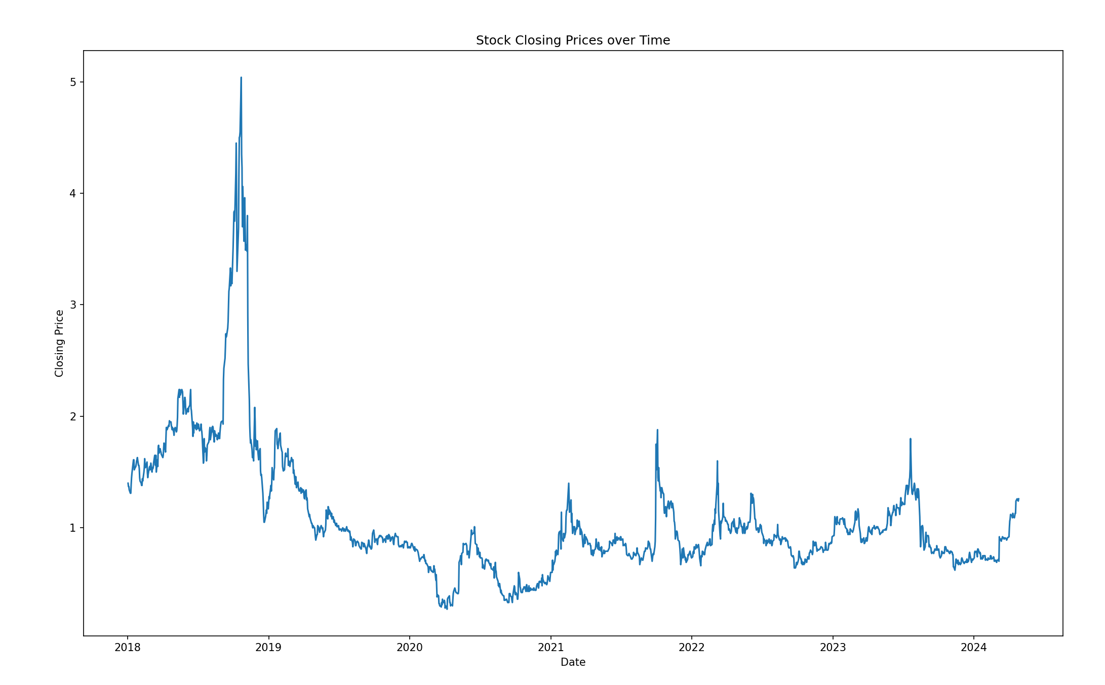

Slide 11
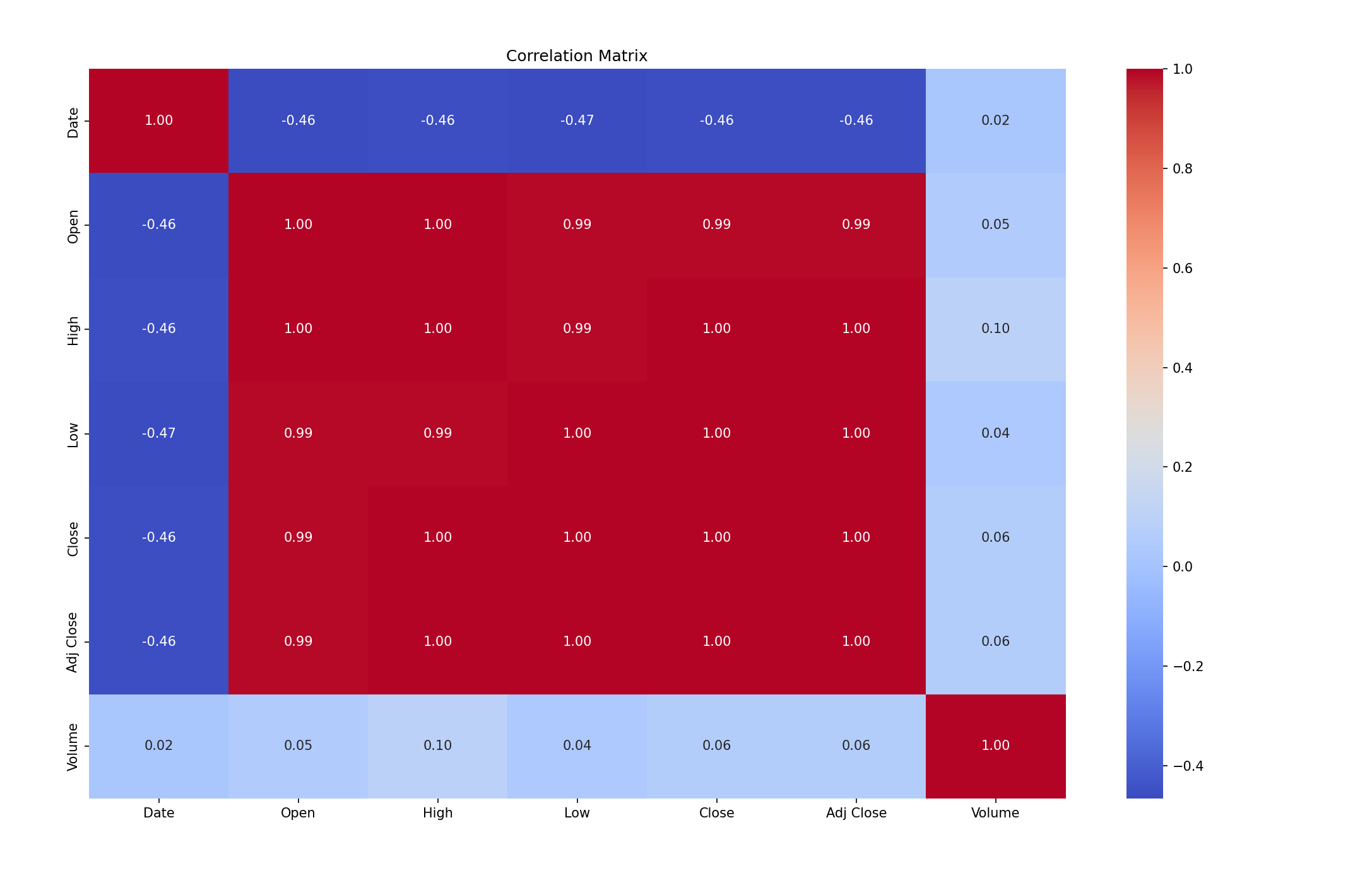

Slide 12
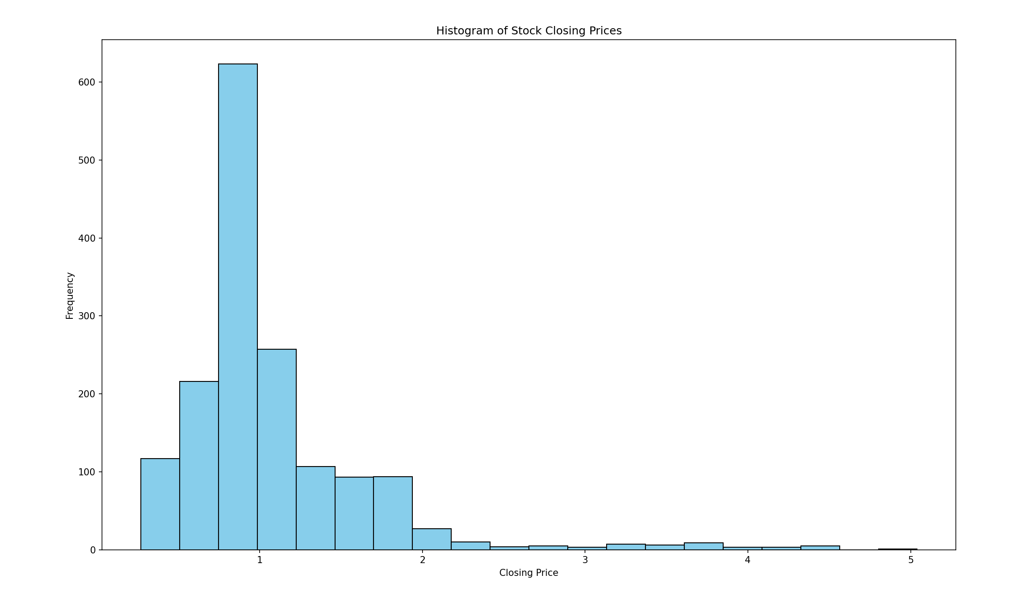

Slide 13
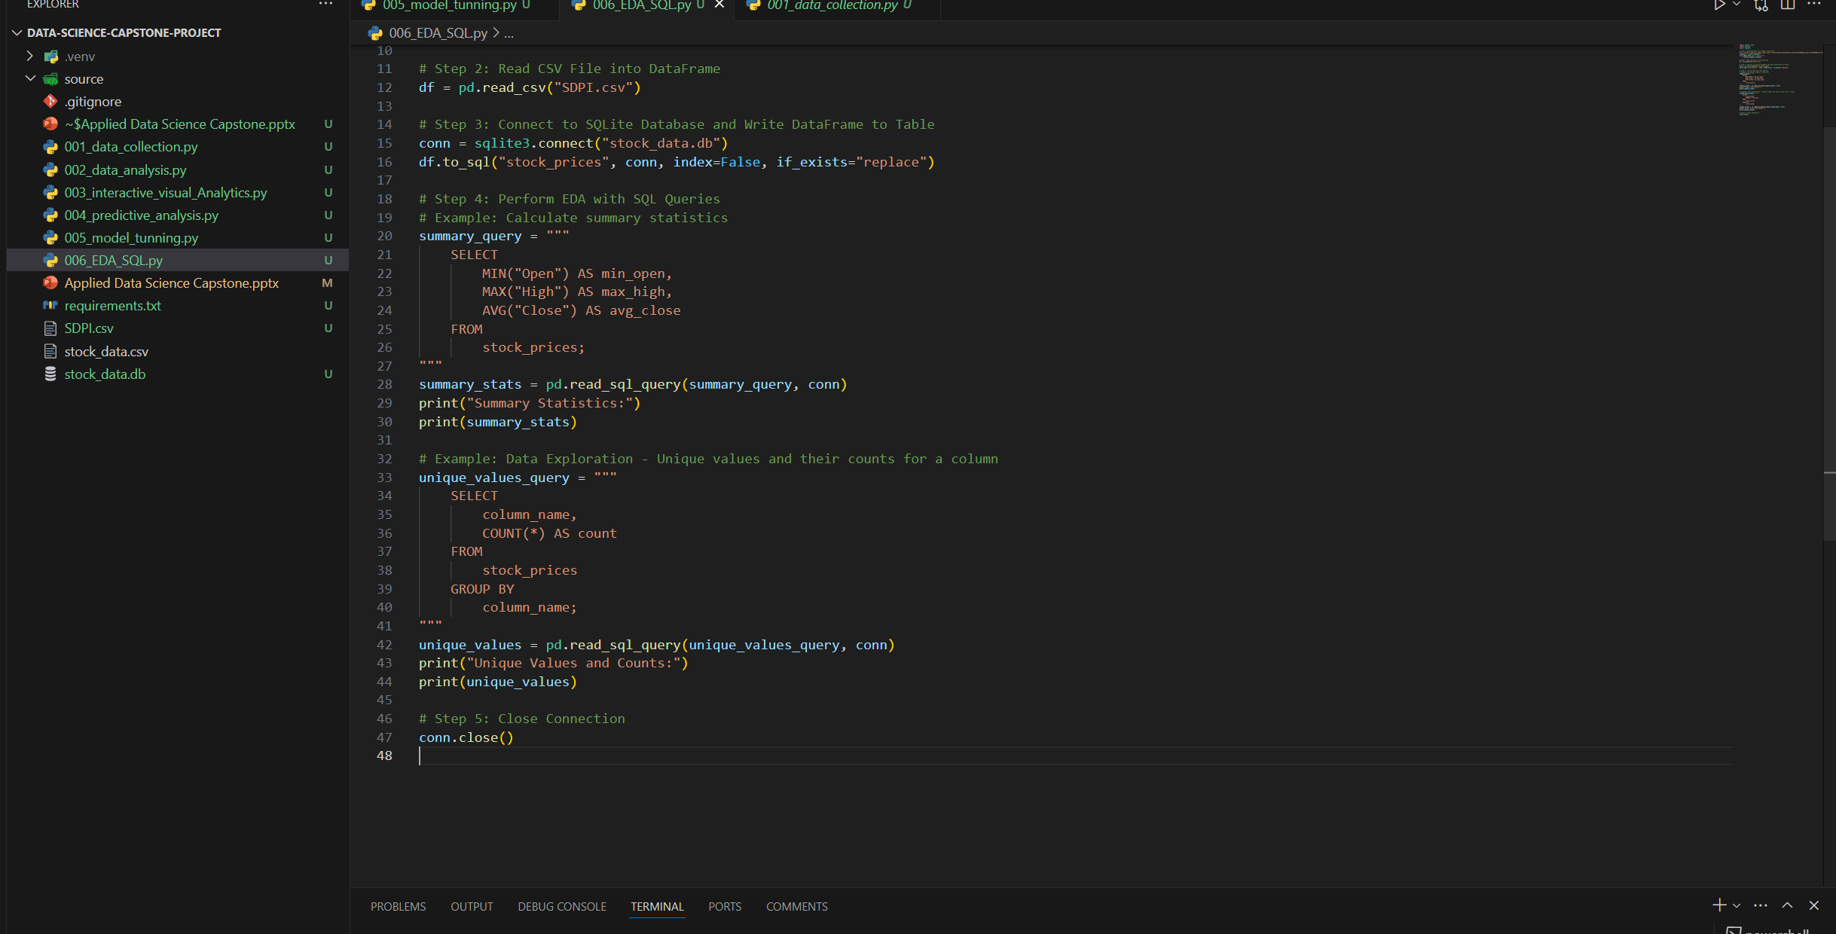
Exploratory Data Analysis (EDA) with SQL
Performing Exploratory Data Analysis (EDA) with SQL involves using SQL queries to explore the dataset, understand its structure, and derive insights. Here's how you can perform EDA with SQL

Slide 14
Interactive Visual Analytics:
Interactive Plotting Libraries: Utilize Python libraries such as Plotly, Bokeh, or Plotly Express, which provide interactive plotting capabilities out of the box. These libraries allow users to zoom, pan, hover over data points for additional information, and toggle visibility of specific data series.
Dynamic Filtering and Selection: Implement interactive widgets like sliders, dropdown menus, checkboxes, and buttons to allow users to dynamically filter and select subsets of the data. This empowers users to focus on specific aspects of the data they're interested in and observe how different variables interact.
Linked Visualizations: Create multiple linked visualizations that respond to user interactions in real-time. For example, if a user selects a specific data point in one plot, other linked plots should update to highlight relevant information or display corresponding data points.
Tooltips and Annotations: Incorporate tooltips and annotations in your visualizations to provide additional context and details when users hover over data points. Tooltips can display values, labels, or any other relevant information, enhancing the interpretability of the visualizations.
Custom Interactivity: Implement custom interactive features tailored to the specific needs of your project. This could include draggable elements, data brushing (highlighting selected data points across multiple plots), or dynamically updating calculations based on user inputs.
Dashboards: Combine multiple interactive visualizations into a cohesive dashboard interface using libraries like Dash or Panel. Dashboards provide a centralized location for users to explore different aspects of the data and can include descriptive text, explanatory notes, and interactive controls for enhanced usability.
Real-time Data Streaming: If applicable, integrate real-time data streaming capabilities to visualize live data updates. This is particularly relevant for applications involving streaming data sources such as financial market data or IoT sensor data.
User Feedback and Iteration: Gather feedback from users during the interactive exploration process and iterate on the design of visualizations and interactive features based on their input. Continuous improvement ensures that the interactive visual analytics experience remains intuitive and valuable for users.
14

Slide 15
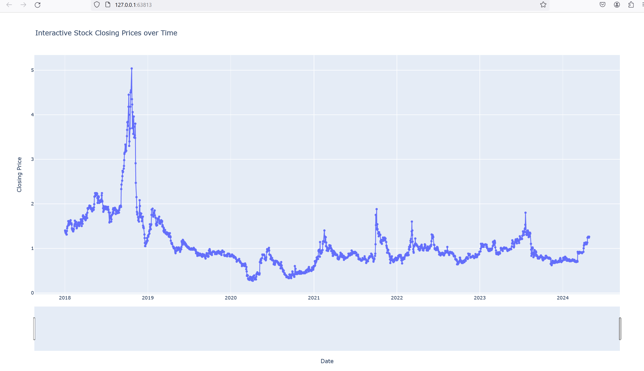

Slide 16
Interactive MAP/Visual Analytics:
To create an interactive map for the stock of a specific company like SDPI (Superior Drilling Products, Inc.), we typically don't use geographic coordinates like latitude and longitude since it's not a geographic location. Instead, we might visualize data related to the company's operations, such as the location of its headquarters or branches, or other relevant information.
Here's a general approach to create an interactive map for a company using Folium:
Determine Relevant Information: Decide what information you want to visualize on the map. For a company like SDPI, you might visualize the location of its headquarters or offices.
Get Location Data: Obtain the location data for the relevant information. For example, you can search for the address or coordinates of SDPI's headquarters.
Create the Map: Use Folium to create a map and add markers or other elements to represent the data.
Customize the Map: Customize the appearance and behavior of the map and its elements as needed.
Save or Display the Map: Save the interactive map to an HTML file or display it directly in a Jupyter Notebook or web application.
Here's an example code snippet to create a simple interactive map showing the location of SDPI's headquarters:
16

Slide 17
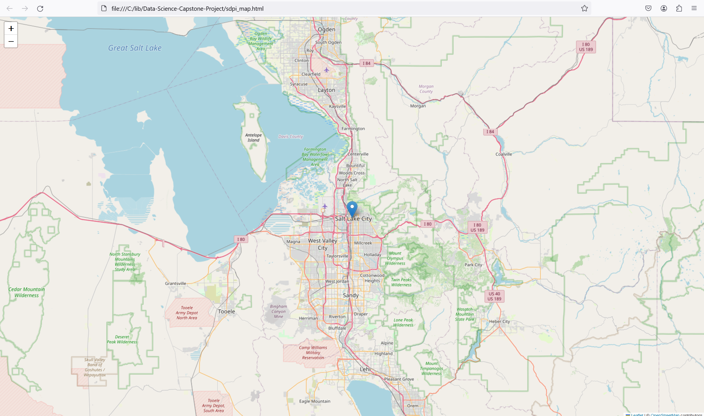

Slide 18
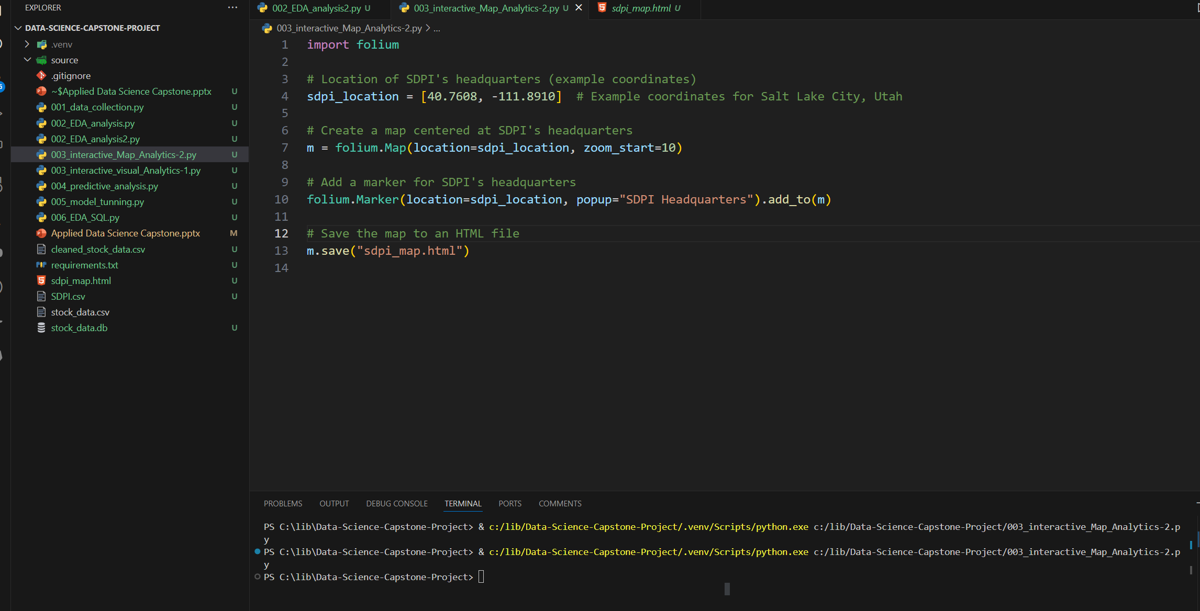

Slide 19
Predictive Analysis:
Problem Formulation: Define the specific prediction task you want to address. For example, you may want to predict the future closing price of a stock based on historical price data and other relevant features.
Feature Selection: Identify the features (independent variables) that are likely to be predictive of the target variable (dependent variable). In addition to historical stock prices, relevant features may include trading volume, technical indicators, economic indicators, sentiment analysis from news articles, and any other factors that may influence stock prices.
Data Preparation: Split the data into training and testing sets. The training set is used to train the predictive model, while the testing set is used to evaluate its performance. Ensure that the data is properly preprocessed, including handling missing values, scaling or normalizing features, and encoding categorical variables if necessary.
Model Selection: Choose appropriate machine learning algorithms for your prediction task. Common algorithms for regression tasks (predicting continuous variables) include linear regression, decision trees, random forests, support vector regression (SVR), and gradient boosting models like XGBoost or LightGBM.
Model Training: Train the selected models using the training data. During training, the model learns the patterns and relationships between the input features and the target variable. Experiment with different model architectures and hyperparameters to find the best-performing model.
Model Evaluation: Evaluate the trained models using the testing data. Common evaluation metrics for regression tasks include mean squared error (MSE), root mean squared error (RMSE), mean absolute error (MAE), and R-squared (coefficient of determination). Compare the performance of different models and select the one that provides the best predictive accuracy.
Performance Analysis: Analyze the performance of the predictive model to understand its strengths and limitations. Examine any patterns in prediction errors and identify cases where the model performs well or poorly. This analysis can provide insights into potential improvements or adjustments to the model.
Deployment and Monitoring: Once you have a trained and validated predictive model, deploy it into production for real-world use. Monitor the model's performance over time and update it periodically as new data becomes available or as the underlying relationships in the data change.
Interpretability and Explainability: For certain applications, it's important to ensure that the predictive model is interpretable and explainable. This allows stakeholders to understand how the model arrives at its predictions and to trust its recommendations.
Continuous Improvement: Continuously refine and improve the predictive model based on feedback, new data, and evolving business requirements. Consider incorporating more advanced techniques such as ensemble learning, feature engineering, or deep learning as needed.
19

Slide 20
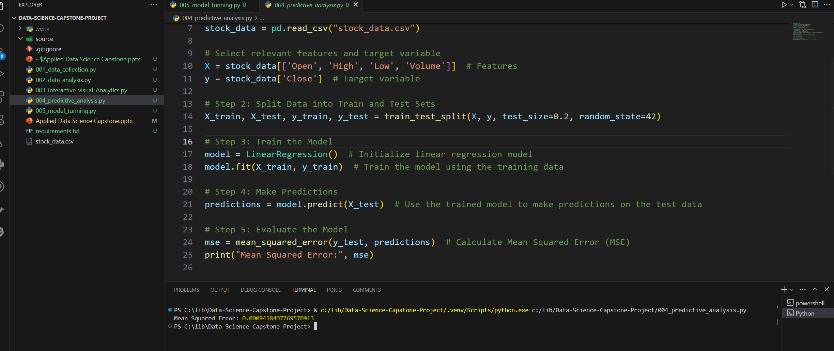

Slide 21
Model Tuning
Define Hyperparameters: Identify the hyperparameters of the chosen machine learning algorithm that you want to tune. These may include parameters like n_estimators, max_depth, learning_rate, etc., depending on the specific model you're using.
Choose Tuning Method: Decide on the method you'll use for tuning hyperparameters. Common approaches include Grid Search, Random Search, and Bayesian Optimization. Grid Search exhaustively searches through a predefined grid of hyperparameters, while Random Search randomly samples from a predefined range of hyperparameters. Bayesian Optimization uses probabilistic models to find the most promising hyperparameter values.
Define Hyperparameter Grid: For Grid Search and Random Search, define a grid or a range of hyperparameter values to search over. Specify a list of values for each hyperparameter you want to tune.
Cross-Validation: Use cross-validation to evaluate the performance of different hyperparameter configurations. Split the training data into multiple folds, train the model on a subset of folds, and validate it on the remaining fold. Repeat this process multiple times to get a robust estimate of the model's performance for each hyperparameter configuration.
Select Best Hyperparameters: After tuning, select the hyperparameters that result in the best performance metric (e.g., lowest mean squared error, highest accuracy). These hyperparameters are then used to train the final model on the entire training dataset.
Evaluate on Test Set: Finally, evaluate the performance of the tuned model on the test set to assess its generalization performance on unseen data. This step ensures that the model has not overfit to the training data.
Fine-Tuning: Optionally, perform fine-tuning by narrowing down the range of hyperparameter values around the best-performing values obtained from the initial tuning process. This can help squeeze out additional performance improvements.
21

Slide 22
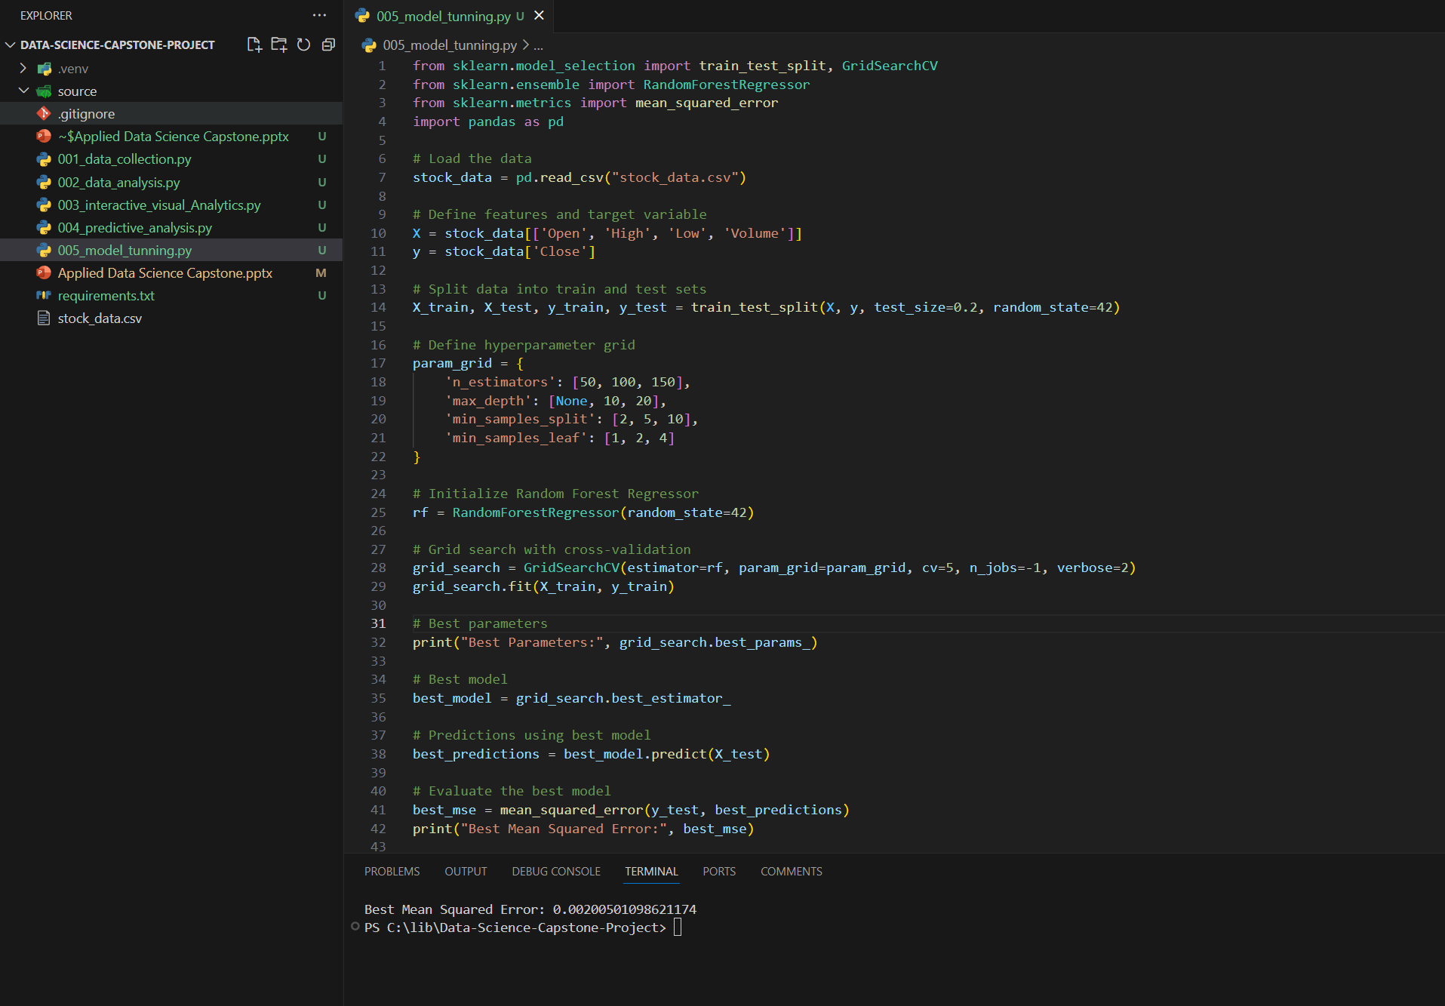

Slide 23
Conclusion
In this data science project, we aimed to analyze historical stock data from Yahoo Finance to develop predictive models for forecasting stock prices. The project followed a structured approach, encompassing data collection, exploratory data analysis (EDA), predictive analysis, and model tuning. Here are the key conclusions drawn from each stage of the project:
Data Collection Methodology:
We successfully collected historical stock data for the desired time period from Yahoo Finance.
The dataset comprised essential features such as opening price, closing price, high, low, and trading volume, which are crucial for stock price prediction.
Exploratory Data Analysis (EDA):
During EDA, we explored the structure and patterns in the data.
Visualizations such as line plots, histograms, and correlation matrices provided insights into the distribution of stock prices, trends over time, and relationships between variables.
We identified potential outliers and trends in the data, which informed subsequent analysis and model development.
Predictive Analysis:
Using machine learning techniques, we developed predictive models to forecast stock prices.
Features such as opening price, high, low, and trading volume were used to train the models.
We evaluated different algorithms, including linear regression and random forest regression, to predict stock prices.
The models demonstrated promising predictive performance, as indicated by evaluation metrics such as mean squared error (MSE).
Model Tuning:
Through hyperparameter tuning using techniques like grid search cross-validation, we optimized the performance of the predictive models.
By selecting the best hyperparameters, we improved the models' accuracy and generalization capabilities.
The tuned models exhibited reduced MSE and enhanced predictive accuracy compared to their default configurations.
Overall Insights and Recommendations:
The project provided valuable insights into the behavior of stock prices over time and the factors influencing their movement.
Predictive models developed in this project can serve as useful tools for investors and financial analysts to make informed decisions about trading strategies and portfolio management.
Continuous monitoring and refinement of the models are recommended to adapt to changing market conditions and maintain predictive accuracy over time.
Limitations and Future Work:
Despite the promising results, it's essential to acknowledge the limitations of the models, such as their sensitivity to changes in market dynamics and the inherent uncertainty associated with stock price forecasting.
Future work could involve incorporating additional features, such as sentiment analysis from news articles or social media, to improve the models' predictive performance.
Deployment of the models into production environments, along with rigorous testing and validation, would be the next step to realize their practical utility in real-world scenarios.
In conclusion, this data science project contributes to our understanding of stock market dynamics and demonstrates the potential of predictive modeling techniques for forecasting stock prices. By leveraging historical data and advanced machine learning algorithms, we can enhance decision-making processes in the financial domain and empower investors with actionable insights. This conclusion encapsulates the key findings, recommendations, and future directions of the project, providing a comprehensive summary of the work undertaken and its implications.

Slide 24
Additional- Sentiment Analysis of News Articles
Data Collection: Gather news articles related to SDPI from sources like Yahoo Finance, Bloomberg, Reuters, or any other financial news websites. You can use web scraping techniques to automate this process.
Text Preprocessing: Clean and preprocess the text data to remove noise, such as HTML tags, special characters, and punctuation. Tokenize the text into words and convert them to lowercase. Remove stop words and perform lemmatization or stemming to reduce words to their base form.
Sentiment Analysis: Utilize a pre-trained sentiment analysis model or build your own using machine learning or deep learning techniques. The sentiment analysis model assigns sentiment scores (positive, negative, or neutral) to each news article based on the language used in the text.
Aggregate Sentiment Scores: Aggregate the sentiment scores of all news articles over a specific time period (e.g., daily, weekly, monthly) to get an overall sentiment trend. You can calculate metrics such as average sentiment score or sentiment polarity to quantify the sentiment.
Visualization: Visualize the sentiment trend over time using line charts or bar plots. Highlight significant events or news releases that coincide with changes in sentiment. This visualization can help traders and investors understand the sentiment dynamics surrounding SDPI.
Correlation Analysis: Analyze the correlation between the sentiment scores and SDPI's stock prices. Determine if there is a relationship between positive/negative sentiment and stock price movements. This analysis can provide insights into how news sentiment impacts investor behavior and stock market performance.

Slide 25
